Slide 1

application: 100PE to 10,000PE

Slide 2
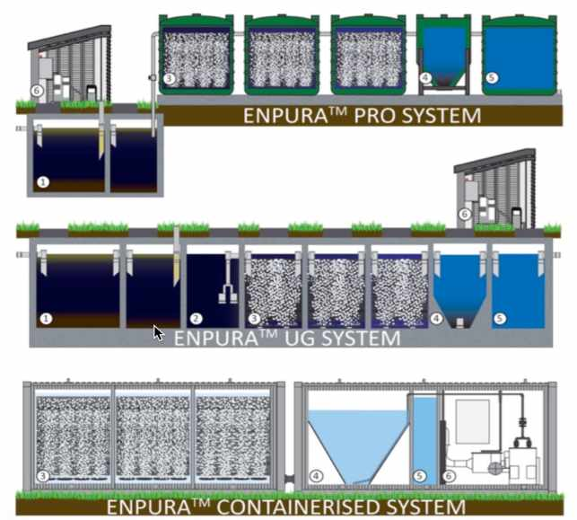

wastewater treatment options to suite any requirement

Slide 3
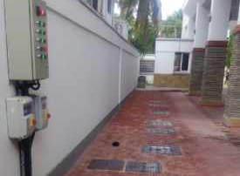
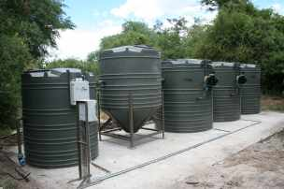
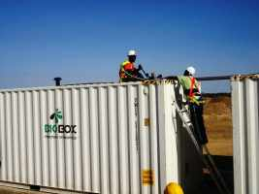
Enpure collection
Enpure ug
Enpure pro
Enpure container
Low profile
Space saving
Easily hidden
Surface can be used for other activities e.g. parking, green space, even buildings
Ideal for new sites
Ideal for sites with sensitive aesthetics
Easiest retrofit option
Fastest delivery & project turnaround
Least disruption to site
Least amount of civil works
Least amount of concrete
Ideal for sites WITH existing SEPTIC/CONSERVANCY TANKS
Ideal for remote locations
mobile
Extremely robust construction
Excellent logistics
Rental & lease hire options
Ideal for oil & gas exploration
Ideal for military
Ideal for remote sites

Slide 4
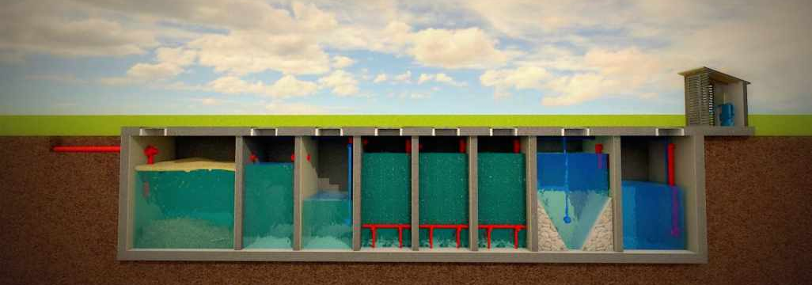
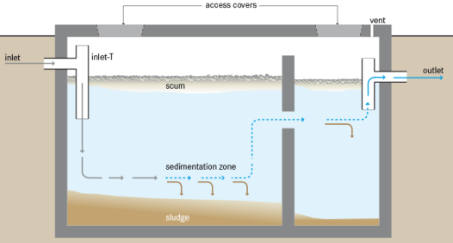
EnpurE process flow
STEP 1: PRIMARY TREATMENT & FLOW EQUALISATION
Primary Treatment is all about separating solids from the wastewater. This entails trapping large solids & settling fine solids. For best result a minimum of 24hr retention is desired.
If Primary Treatment is too small the Solids & Sludge will buildup too fast! Enough storage volume is required to allow Organic Solids & Sludge to be broken down over time through anaerobic biological processes
The sewage is gravity fed into the 1st chamber of the Primary Treatment Tank.
The buffer chamber equalizes the peak flows and regulates the amount of effluent that is fed into the Bioreactors.
Effective Primary Treatment can reduce BOD by up to 40% and TSS by up to 80%
Inside the tank, the solids sink to the bottom while the grease and fats float to the top.
1st Chamber
Primary Treatment
2nd Chamber
Primary Treatment
Buffer
Chamber
Primary Treatment stage creates an anaerobic treatment environment where the organic solids are broken down & digested.
Primary Treated wastewater moves across and into the Buffer Chamber.
Wastewater is fed to the Bioreactor Chambers for biological treatment. The plant runs at the maximum efficiency when the hourly feed rate is spread out over 24hrs

Slide 5
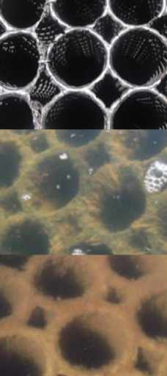
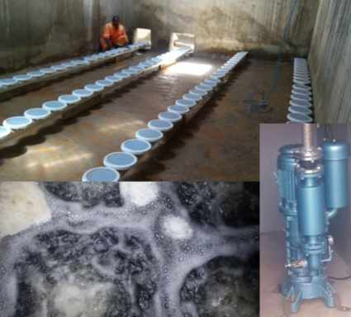
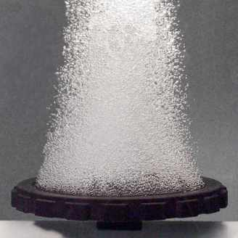
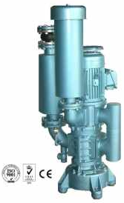
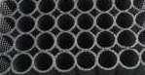
EnpurE process flow
STEP 2: AEROBIC BIOLOGICAL TREATMENT
One of the KEY BENEFITS of Fixed-Film Media is that the Waste Sludge Production is very low. This means the volume of waste sludge sent to Primary Treatment is little. What little sludge sent back and stored in Primary Treatment is usually digested by anaerobic process. Therefore no Buildup of Sludge to be removed by exhausters!
NEW MEDIA
BIOMASS GROWTH
BIOMASS GROWTH
FINE BUBBLE AERATION
Inside the Bioreactors, an enormous population of specialized bacteria grow on the fixed film media. The organisms survive by feeding on the nutrients present in the wastewater, as well as oxygen introduced by aeration.
The effluent then passes into the Clarifier where the sludge settles at the bottom and the clear water separates at the top.
Aeration is required to:
Provide Oxygen to the Bacteria
To circulate the water bringing food (waste) & Oxygen into contact with the bacteria growing on the Fixed-Film Media
The Bubbles scour the Fixed-Film Media brushing off excess Biomass. This keeps the Biofilm thickness on the Fixed-Film Media in check
Extremely Robust – 15 Year Warrantee!
High Surface Area
Huge Bacteria Population
Anti-Clog Design
Easy to clean if needed
Efficient Oxygen Saturation
Reduces Size of Aeration Blower
Reduces Operating Cost
GTB Positive displacement Aeration Blower
Heavy duty & durable
Low Noise & vibration
Efficient
Low power costs
Replaceable motor
Pressure protection
The final product is a clear & odourless effluent ready for discharge to the environment or water reuse applications such as irrigation
3 Stage Bioreactos
Storage
Tank
Clarifier
The accumulated sludge at the bottom of the clarifier is recycled back to the Primary Treatment tank and the clear water enters the storage tank.
FIXED FILM MEDIA

Slide 6

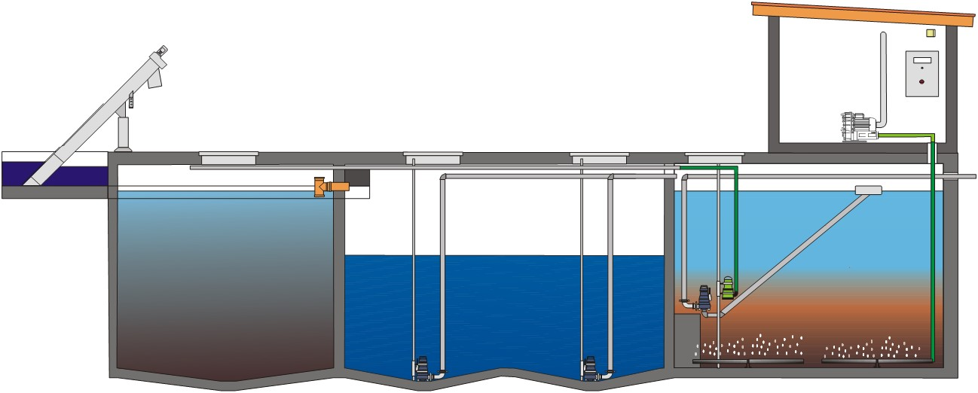
wastewater treatment to suite YOUR BUDGET

Slide 7
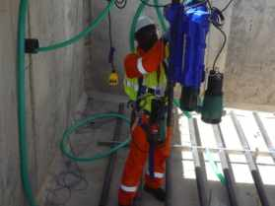
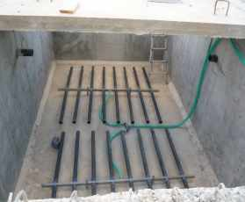
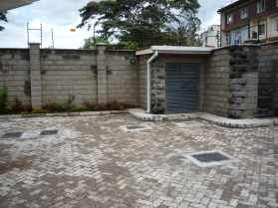
VERSATILITY & economy
SBR BENEFITS
SBR RETROFITS
ECONOMIC PRICE POINT
Low profile/Easily hidden
Ideal for sites with sensitive aesthetics
Space saving
Surface can be used for other activities e.g. parking, green space, even buildings
ENTRIE PROCESS RUN IN A SINGLE SBR REACTOR TANK, INCLUDING DE-NITRIFICATION
SIMPLE retrofit option
POTENTIAL TO RETROFIT TO EXISTING SEPTIC/CONSERVANCY TANKS
Fastest delivery & project turnaround
Least disruption to site
POTENTIAL FOR NO civil works REQUIRMENT
EQUIPMENT MAKES UP SMALL PACKAGES FOR SHIPPING. SAVING COST AND COMPLICATION

Slide 8
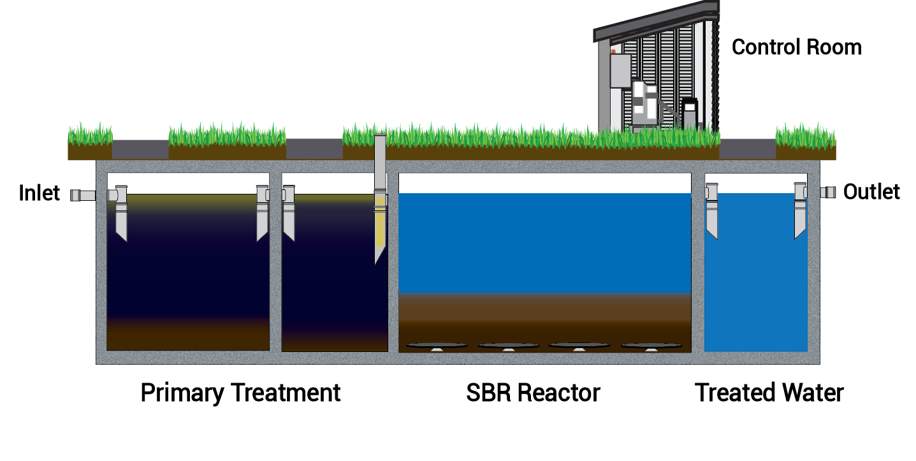

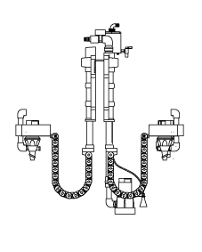
SBR MAX process flow
Primary Treatment is all about separating solids from the wastewater. This entails trapping large solids & settling fine solids. For best result a minimum of 24hr retention is desired.
If Primary Treatment is too small the Solids & Sludge will buildup too fast! Enough storage volume is required to allow Organic Solids & Sludge to be broken down over time through anaerobic biological processes
The sewage is gravity fed into the 1st chamber of the Primary Treatment Tank.
Wastewater is fed to the SBR Reactor Tank for Aerobic Biological Treatment. The SBR Process involves a cycle of activities which are typically repeated 4 x a day
CLEAR WATER DISCHARGE
Effective Primary Treatment can reduce BOD by up to 40% and TSS by up to 80%
SETTLING
1st Chamber
Primary Treatment
2nd Chamber
Primary Treatment
AERATION
Inside the tank, the solids sink to the bottom while the grease and fats float to the top.
ATTENTION:
The Aeration actually consists of two steps:
Longer Periods to remove Organics & Nutrients (commonly measured as BOD & COD). Also during the Longer periods Nitrification takes place.
Intermittent Aeration, usually just after fresh wastewater has been fed to the SBR Reactor. The Wastewater high in Carbon allows conditions for De-nitrification. De-nitrification removes Nitrate, and the process occurs under Anoxic conditions (low oxygen just before septic conditions). The intermittent Aeration is actually for mixing rather than providing oxygen.
During Aeration the enormous population of bacteria (Activated Sludge) is mixed with the recently added wastewater. The Bacteria consume the waste and oxygen provided.
The Clear Water is Discharged out, usually to a contact storage tank for Sterilization. The Treated Water is fit to release to the Environment, or for reuse such as irrigation
Primary Treatment stage creates an anaerobic treatment environment where the organic solids are broken down & digested.
After Aeration the SBR Reactor is left still for at least an hour. The Activated Sludge settles very well and leaves behind a clear layer of water
The 2nd Chamber also acts as a buffer chamber to
equalizes the peak flows

Slide 9
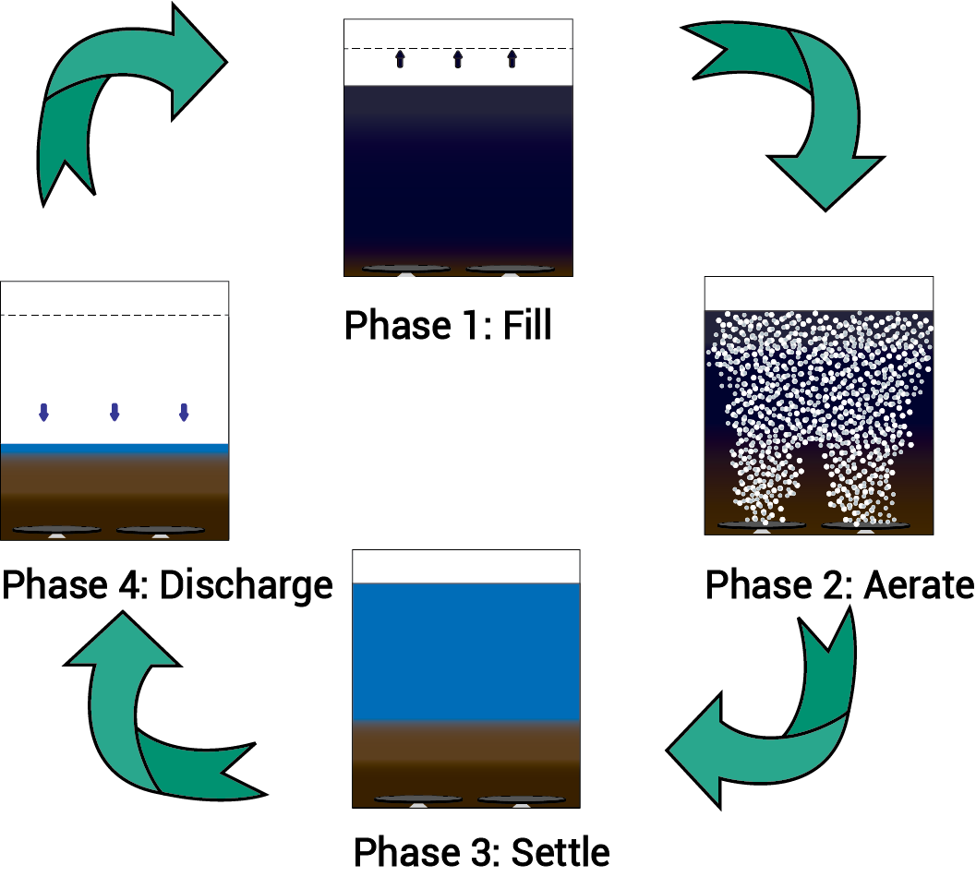
SBR process CYCLE
STEP 4: CLEARWATER DISCHARGE
STEP 3: SETTLING
STEP 1: FEED
STEP 2: AERATION
Gravity Feed from 1st Primary Treatment Tank
TREATED WATER
Feed Pump
Discharge Pump
AND SO THE NEXT CYCLE STARTS ETC…
2nd Chamber Primary Treatment / Buffer tank
SBR Reactor

Slide 10
Comparisons
 | DTF | ENPURA
Investment Cost | 8,400,000/= | 14,000,000/=
Capacity | 23m3/dy | 75m3/dy
Capital Investment/m3 | Kshs. 365,217/m3 | Kshs. 186,666/m3
Land Suitability | Slope required | No slope required
Sludge | Black sludge, septic until dried | Brown sludge, non septic

